Slide 1

KLM-GOMS

Slide 2
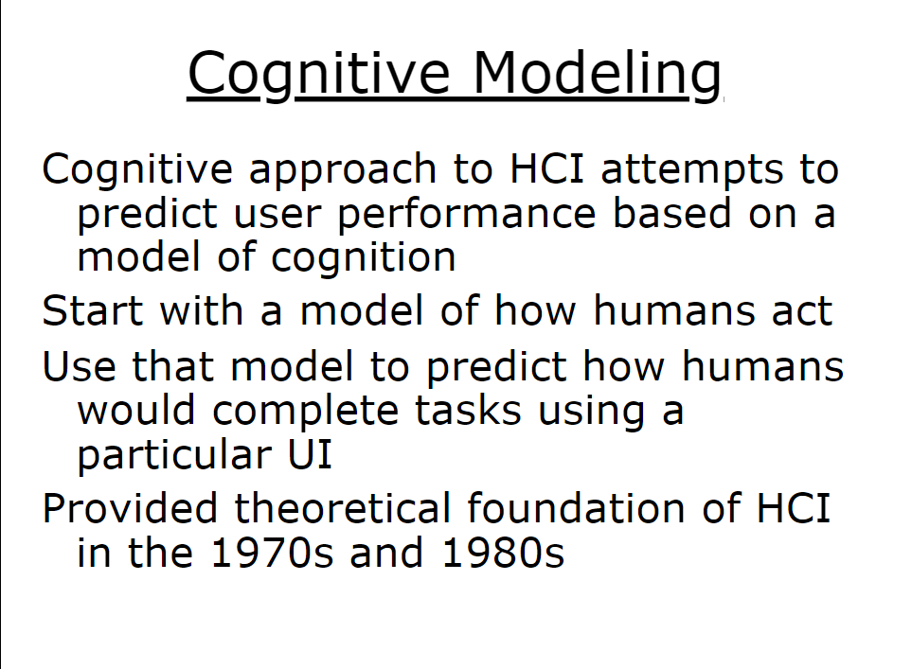
Notes:
CTT (cognative time techniques)

Slide 3
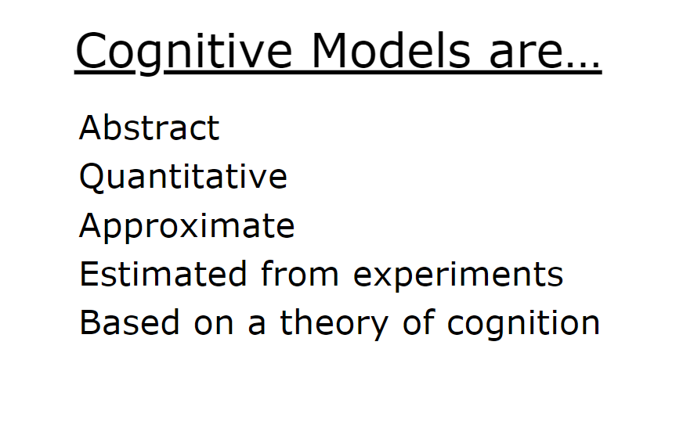
Notes:
1. Abstract modeling is a way of learning skills and behaviors by the indirect observation of others

Slide 4
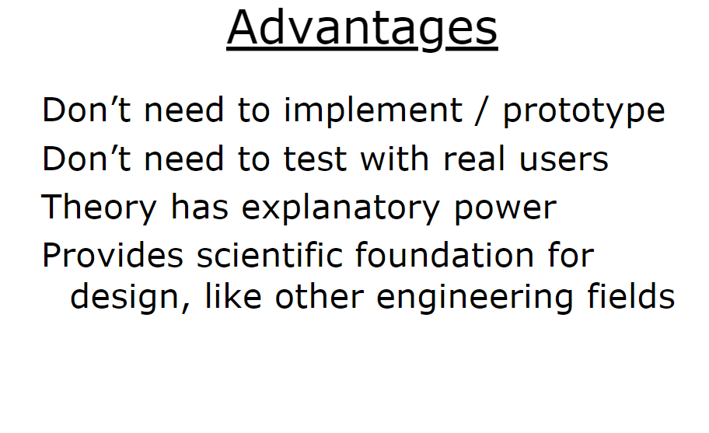
Notes:
1.underlying behavioral responses in a specific task;
2. Model parameters can be interpreted in an objective and formally described manner;

Slide 5
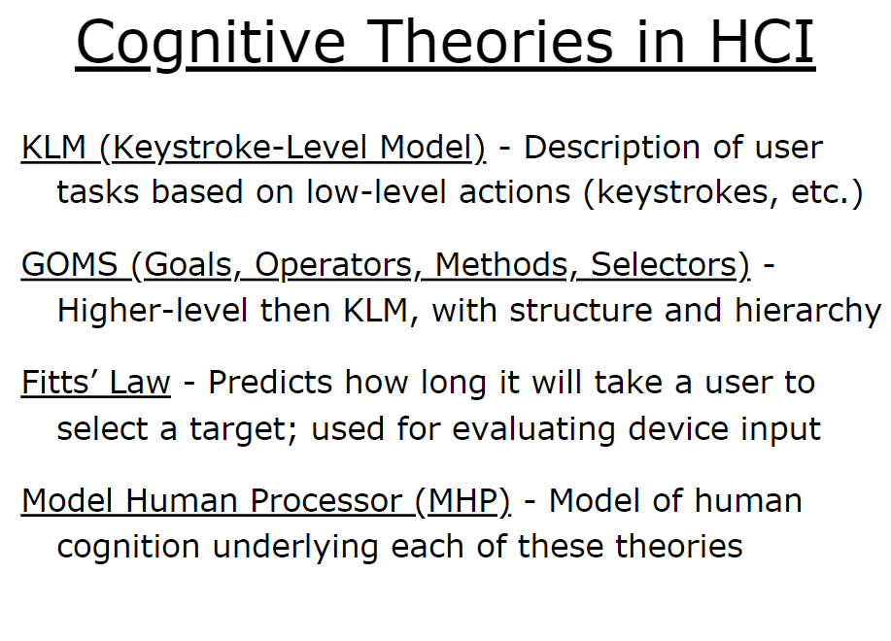

Slide 6
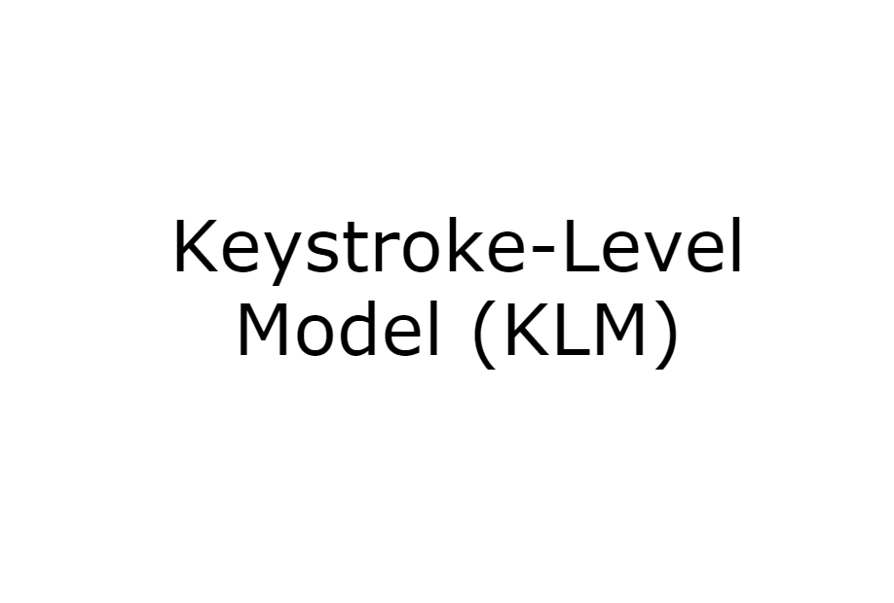
Notes:
Task analysis on low level actions

Slide 7
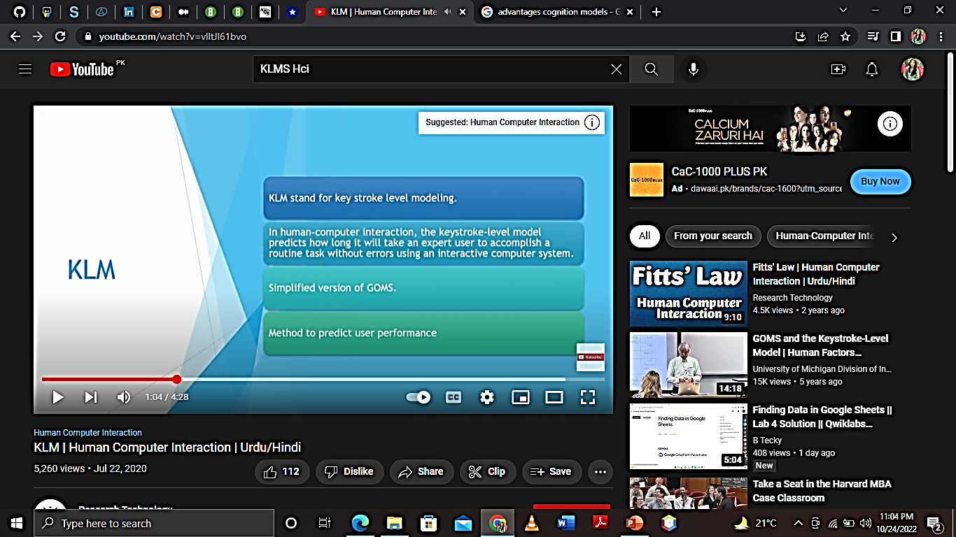

Slide 8
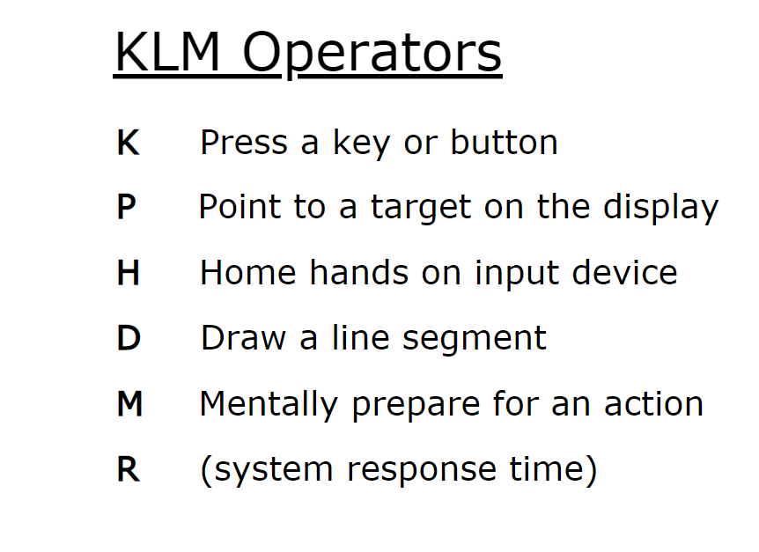
Notes:
There are 6 categories of operators
Estimate execution time by listing the performance of user w rt to operators
R: after input system’s response in out put
basically estimation of over all time for processing a task cognitive ly

Slide 9
The number of Ms in a method depends on the knowledge and skill of the user. Heuristics are given to help decide where an M should be placed in a method. For example, when pointing with the mouse a button press is usually fully anticipated and no M is needed between both operators.

Slide 10
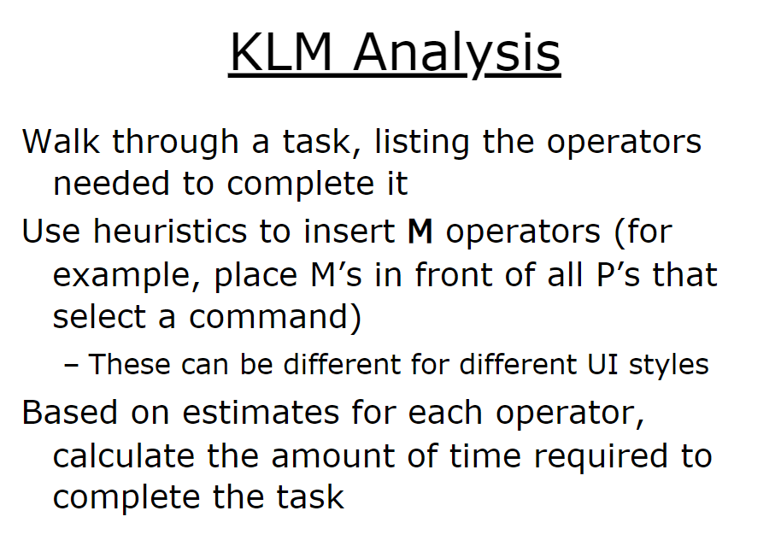
Notes:
M : mentally prepare
P : point to target the display

Slide 11
The following table shows the heuristics for placing the M operator:
hideBegin with a method encoding that includes all physical operators and response operations. Use Rule 0 to place candidate Ms, and then cycle through Rules 1 to 4 for each M to see whether it should be deleted.
Rule 0 | Insert Ms in front of all Ks that are not part of argument strings proper (e.g., text strings or numbers). Place Ms in front of all Ps that select commands (not arguments).
Rule 1 | If an operator following an M is fully anticipated in the operator just previous to M, then delete the M (e.g., PMK -> PK).
Rule 2 | If a string of MKs belong to a cognitive unit (e.g., the name of a command), then delete all Ms but the first.
Rule 3 | If a K is a redundant terminator (e.g., the terminator of a command immediately following the terminator of its argument), then delete the M in front of the K.
Rule 4 | If a K terminates a constant string (e.g., a command name), then delete the M in front of the K; but if the K terminates a variable string (e.g., an argument string) then keep the M.

Slide 12
operator | time (sec)
K | total typing test time/total number of non-error keystrokes Guidelines:^{[11][12]} .08 (135 wpm: best typist) .12 (90 wpm: good typist) .20 (55 wpm: average skilled typist) .28 (40 wpm: average non-secretary typist) .50 (typing random letters) .75 (typing complex codes) 1.20 (worst typist and unfamiliar with the keyboard)
P | 1.1^{[11][12]}
H | 0.4^{[11][12]}
D | .9n_{D} +. 16 l_{D}^{[11][12]}
M | 1.35^{[11][12]}
R | system dependent^{[11][12]}
suggested operators
B (mouse button press or release) | 0.1^{[13]}
Click a Link/ Button | 3.73^{[14]}
Pull-Down List (No Page Load) | 3.04^{[14]}
Pull-Down List (Page Load) | 3.96^{[14]}
Date-Picker | 6.81^{[14]}
Cut & Paste (Keyboard) | 4.51^{[14]}
Typing Text in a Text Field | 2.32^{[14]}
Scrolling | 3.96^{[14]}

Slide 13
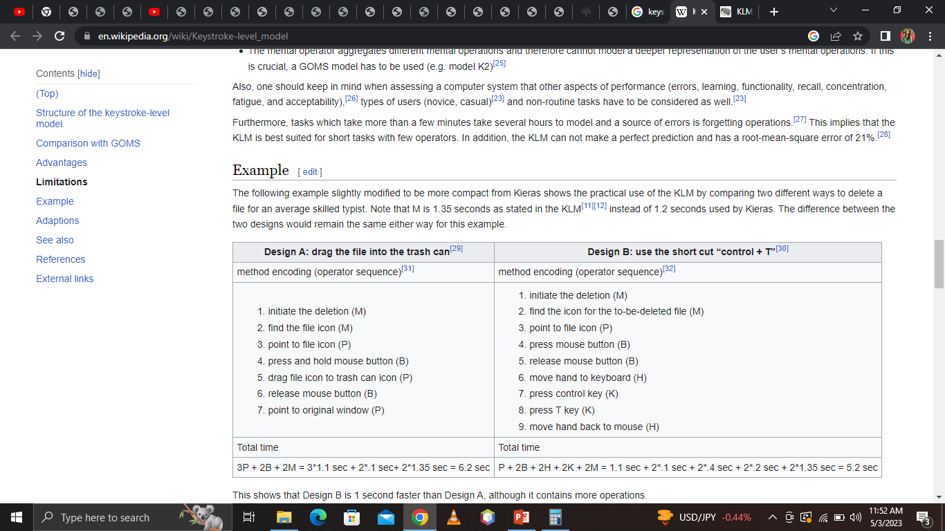
Example :Drag a file to recycle bin

Slide 14
Design 2 : Design B: use the short cut “control + T”

Slide 15
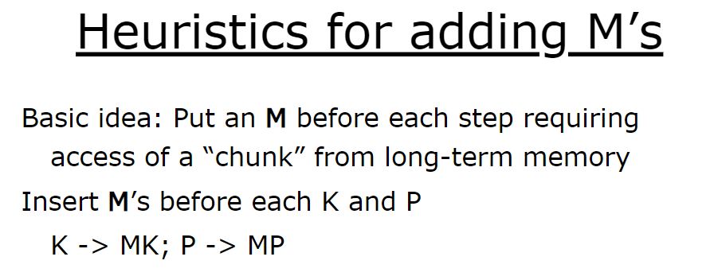

Slide 16
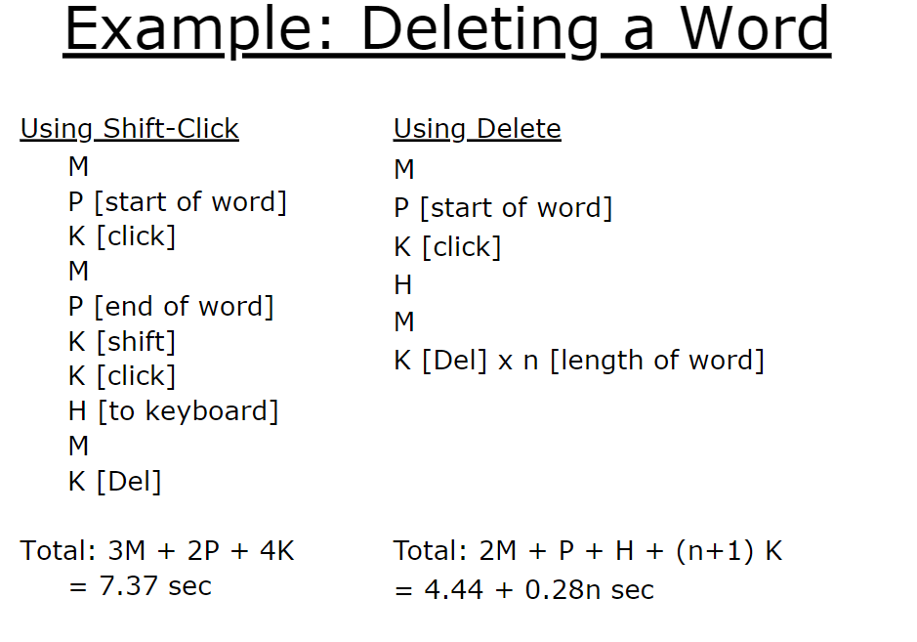

Slide 17
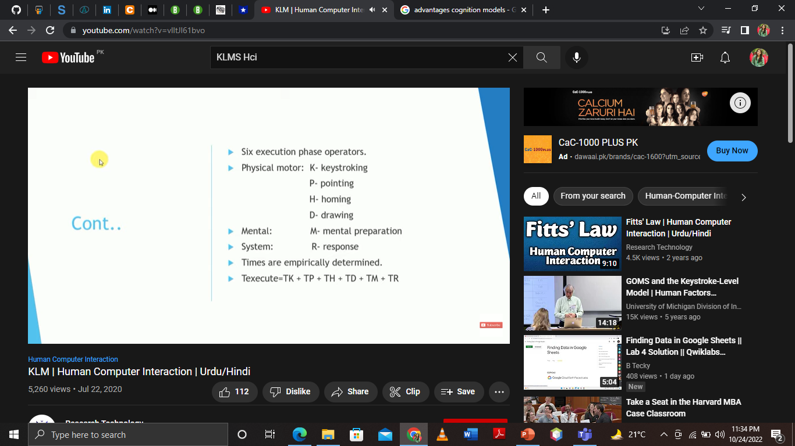
Notes:
Physical motors: using hands and human input channels

Slide 18
Advantages
The KLM was designed to be a quick and easy to use system design tool, which means that no deep knowledge about psychology is required for its usage.
Also, task times can be predicted (given the limitations) without having to build a prototype, recruit and test users, which saves time and money.

Slide 19
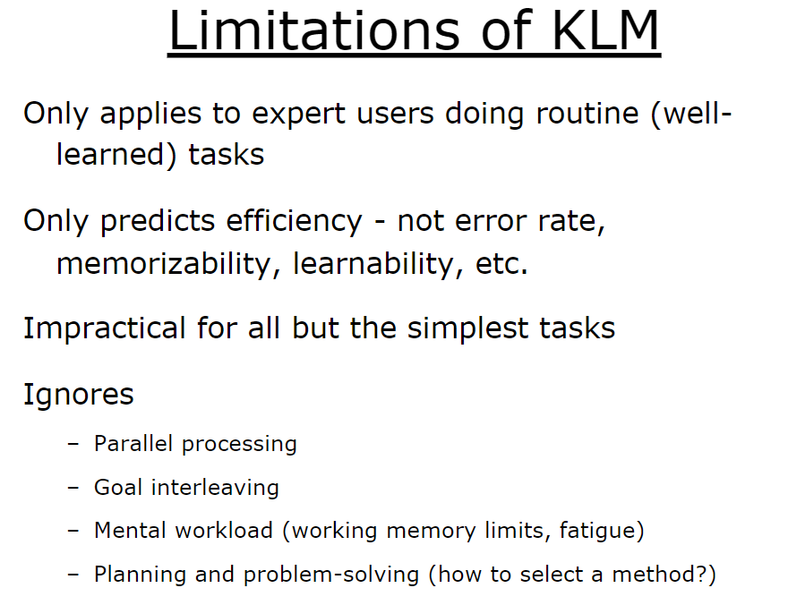
Notes:
Summary :
how much time an expert user take to interact with computer.
it interaction is depending on 6 operators
On this basis we measure the performance of users. With some task

Slide 20
Limitations :
The keystroke-level model has several restrictions:
It measures only one aspect of performance: time, which means execution time and not the time to acquire or learn a task.
Notes:
Also, one should keep in mind when assessing a computer system that other aspects of performance (errors, learning, functionality, recall, concentration, fatigue, and acceptability) types of users (novice, casual)[ and non-routine tasks have to be considered as well.

Slide 21
Class task:
- Scenario 1, New User : deleting a reverse video icon and point original video
Assumptions:
Our basic assumption is that the new user will stop and check feedback from system at every step.
The general procedure such a user will follow is to:
find the file icon,
make sure it is selected,
and drag it to the trash can,/ press the delete key
verify that the icon is reverse-video (del reverse videos),
and then verify the whole process by checking that the trash can is bulging
find the original video and point it.

Slide 22
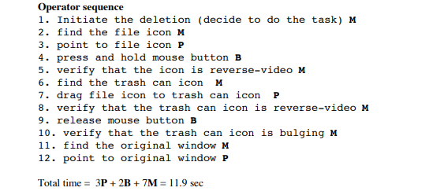
Answer:

Slide 23
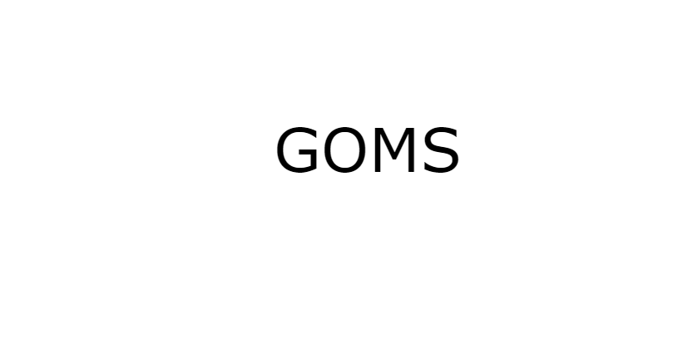

Slide 24
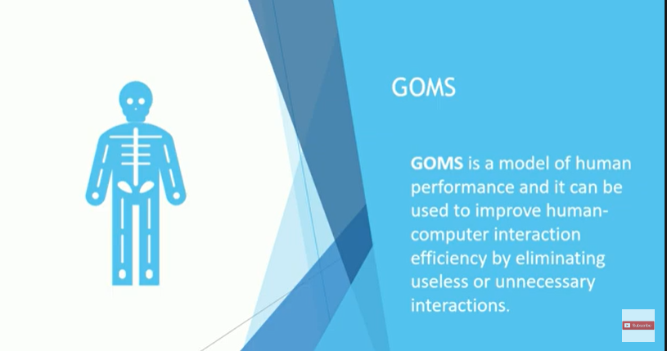
Notes:
For example while using computers interactions eliminate extra unnecessary tasks… for. Um neccery pdf adds and etc. and if user is typing on words to eliminate this 2

Slide 25
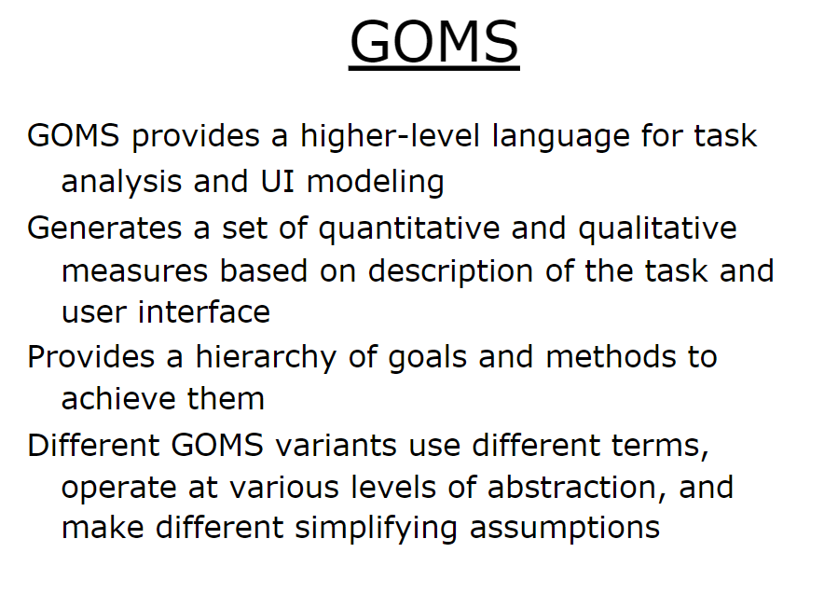

Slide 26
GOMS is an abbreviation from: G → Goals O → Operators M → Methods S → Selection

Slide 27
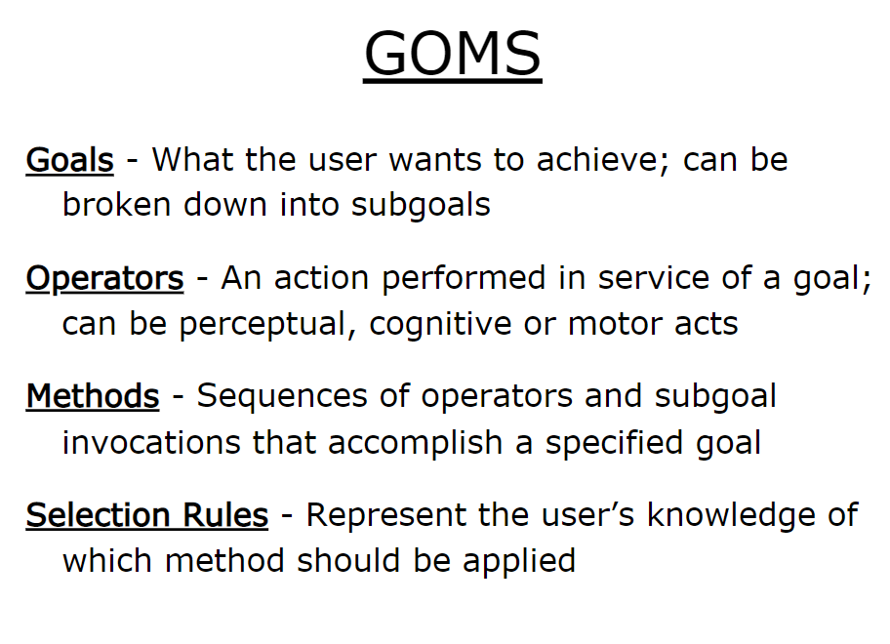
Notes:
Selection : there can be more than one methods then we can select which is best and efficient to use in this situation
depending on user behavior
( select which is easy for users)

Slide 28
•What does a GOMS task analysis involve?
–Involves defining and then describing the user’s
Goals:
–Something that the user tries to accomplish (action-object pair, e.g. delete word)
–Include context
Methods:
–Well learned sequence of steps that accomplish a task
–How do you do it on this system? (could be long and tedious…)

Slide 29
•Selection Rules:
–Only when there are clear multiple methods for the same goal.
•Operators:
–Elementary perceptual, cognitive and motor acts that cause change (external vs. mental)
–Also uses action-object pair (e.g. press key, select menu, make gesture, speak command...)
–mostly defined by hardware and lower-level software

Slide 30
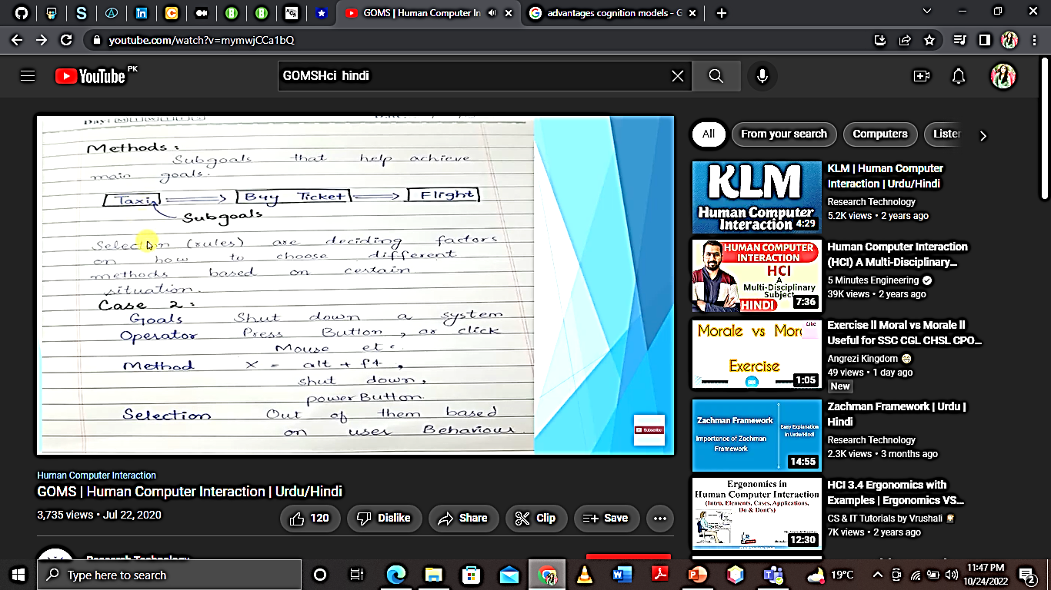

Slide 31
We can distinguish a few types of GOMS e.g. CPM-GOM, NGOMSL, or SCMN-GOMS), but the most popular is KLM-GOMS (Keystroke Level Model) where we can empirically check values for operators like button presses, clicks, pointer movement time, etc.

Slide 32
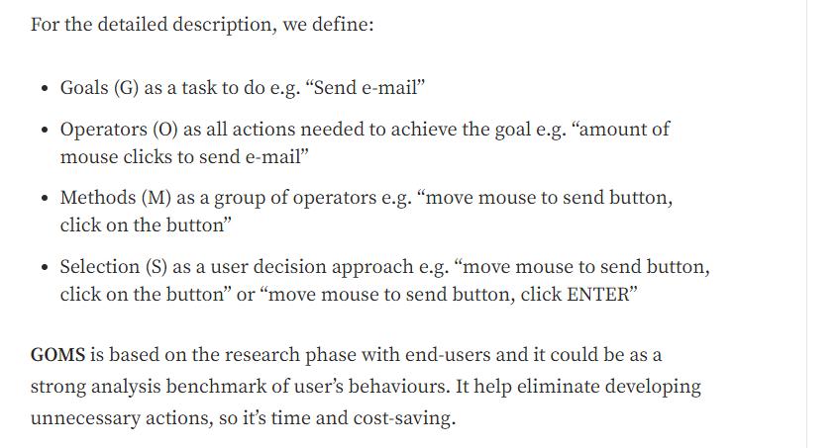
Email example in GOMS ANALYSIS
we define:
Goals (G) as a task to do e.g. “Send e-mail”
Operators (O) as all actions needed to achieve the goal e.g. “amount of mouse clicks to send e-mail”
Methods (M) as a group of operators e.g. “move mouse to send button, click on the button”
Selection (S) as a user decision approach e.g. “move mouse to send button, click on the button” or “move mouse to send button, click ENTER”

Slide 33
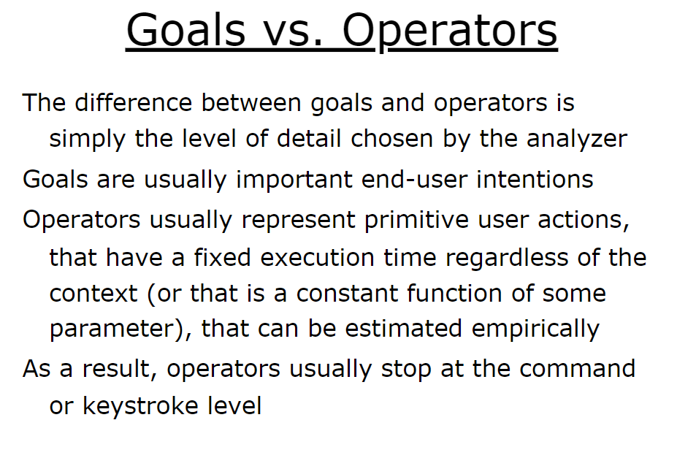

Slide 34
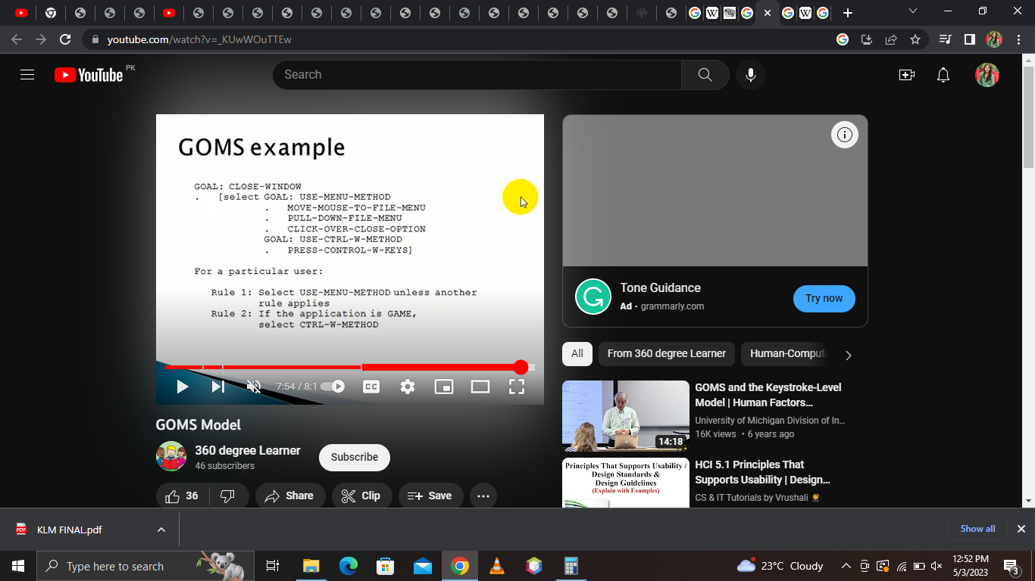

Slide 35
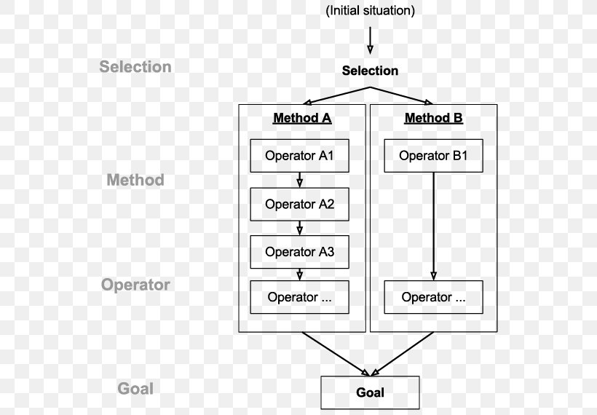

Slide 36
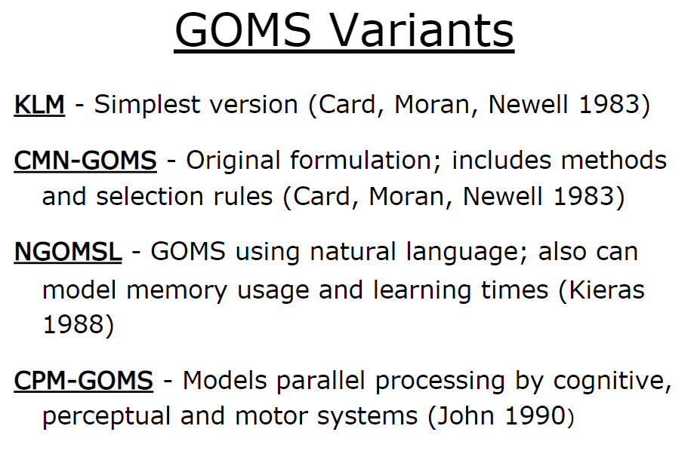

Slide 38
Solutuon………..
1. initiate the setting change (M)
2. find the profile icon (M)
3. point to the profile icon (P)
4. tap icon (B)
5. find setting option (M)
6. point to the option (P)
7. tap option (B)
8. find notifications option (M)
9. point to the option (P)

Slide 39
10. tap option (B)
11. find Mobile notifications option (M)
12. point to the option (P)
13. tap option (B)
14. find mentions, replies and photo tag option (M)
15. point to the option (P)
16. tap option (B)
17. find off option (M)
18. point to the option (P)
19. tap option (B)
20. verify change on screen (M)

Slide 40
The above sequence will result in : 8M + 6B + 6P
Common correct adjustments to the above would include:
adding a homing to the begining where the person has to move their hand to the screen.
• omitting the verify at the end since it does not technically need to be there
• add the actions necessary to back out of the screen back to the home screen

Slide 41


